Slide 1
Miss. Erdman
Classroom Level System

Slide 2
Agenda
Classroom Rules
Classroom Level System
Negative Days
Rewards
Expectations
Mystery Motivators
Explanation of levels
Tin
Questions

Slide 3
Classroom rules
1. Students are to bring all required materials and supplies to class each day.
2. Students are to be in their seats, quiet, and ready to work when the tardy bell rings.
3. Students are to follow directions the first time they are given.
4. Students are to raise their hand to be recognized before speaking.
5. Students are to remain in their seats unless given permission to get up.
6. Students should not eat, drink, or chew gum in the classroom.

Slide 4
Classroom level system
The level system is based on Safe, Respectful and Responsible behaviors.
Each level has expectations to improve school behavior along with tangible rewards to motivate our students.
Each student will show success by earning positive, neutral, or negative days.
Each student will be provided with a point sheet at the beginning of the day. They will carry it with them throughout the school day in order to receive immediate feedback from their teachers.
As students progress through the level system the amounts of verbal redirections allowed from staff will decrease before they loose a point.

Slide 5
Classroom level system
Each student can earn a maximum of 27 points per day.
Positive days are 24 points and higher
Neutral days (do over days without dropping in the level system) are 22-23 points
Negative days are 21 and below.

Slide 6
Negative days
If students earn 1 negative day they restart their current level unless it was an office referral.
If the behavior warrants an office referral then the students drop immediately to tin.
If students have 2 consecutive negative days they will be placed on tin.
The expectation is that they complete 2 consecutive positive days in order to return to the level the teacher and social worker see fit.

Slide 7
Rewards
Throughout the year our classes will go on Community Based Trips also knows as, CBTs.
They are privileges that your child had earned due to positive behaviors.
These trips are vital to rewarding positive behaviors and making the level system work.
Student will also receive more frequent smaller rewards in the classroom.

Slide 8
expectations
SAFE
In assigned area
Staying in seat
Asking permission to leave
Hands and feet to self
Appropriate language

Slide 9
expectations
RESPONSIBLE
Homework written in agenda and signed
Point sheet signed and handed in daily
Passing classes:
- Bronze/Silver (80%)
- Gold (90%)
- Platinum (100%)

Slide 10
expectations
Respectful
Appropriate language
Appropriate gestures
Appropriate topics when talking with peers
Positive interactions with staff
Positive interactions with peers
No writing on self or others

Slide 11
rewards
Bronze:
Eat lunch in cafeteria
During free time allowed to read, color, or silent activity at seat
Silver
Eat lunch in cafeteria
During free time allowed music at seat (No computers)
Eligible for CBTs (Must not owe work)
Eligible for Mystery Motivators

Slide 12
rewards
Gold
Eat lunch in cafeteria
During free time allowed music, computers, bean bags
Eligible for CBTs (must not owe work)
Eligible for mystery motivators
Can have one time order in lunch in ES or SW room
May choose to hand in point sheets per week verses daily

Slide 13
rewards
Platinum
Eat lunch in cafeteria
During free time allowed music, computers, bean bags
Eligible for CBTs (must not owe work)
Eligible for Mystery Motivators
Can have one time lunch either out in the community or choose a friend (approved by the staff) to order lunch in.
No point sheet necessary
Will assist in planning next CBT

Slide 14
Mystery motivators
Will be given randomly
A random reward that will be given to those who earned it at the moment
Examples (candy, pancakes, etc…)
Rewards good behaviors!

Slide 15
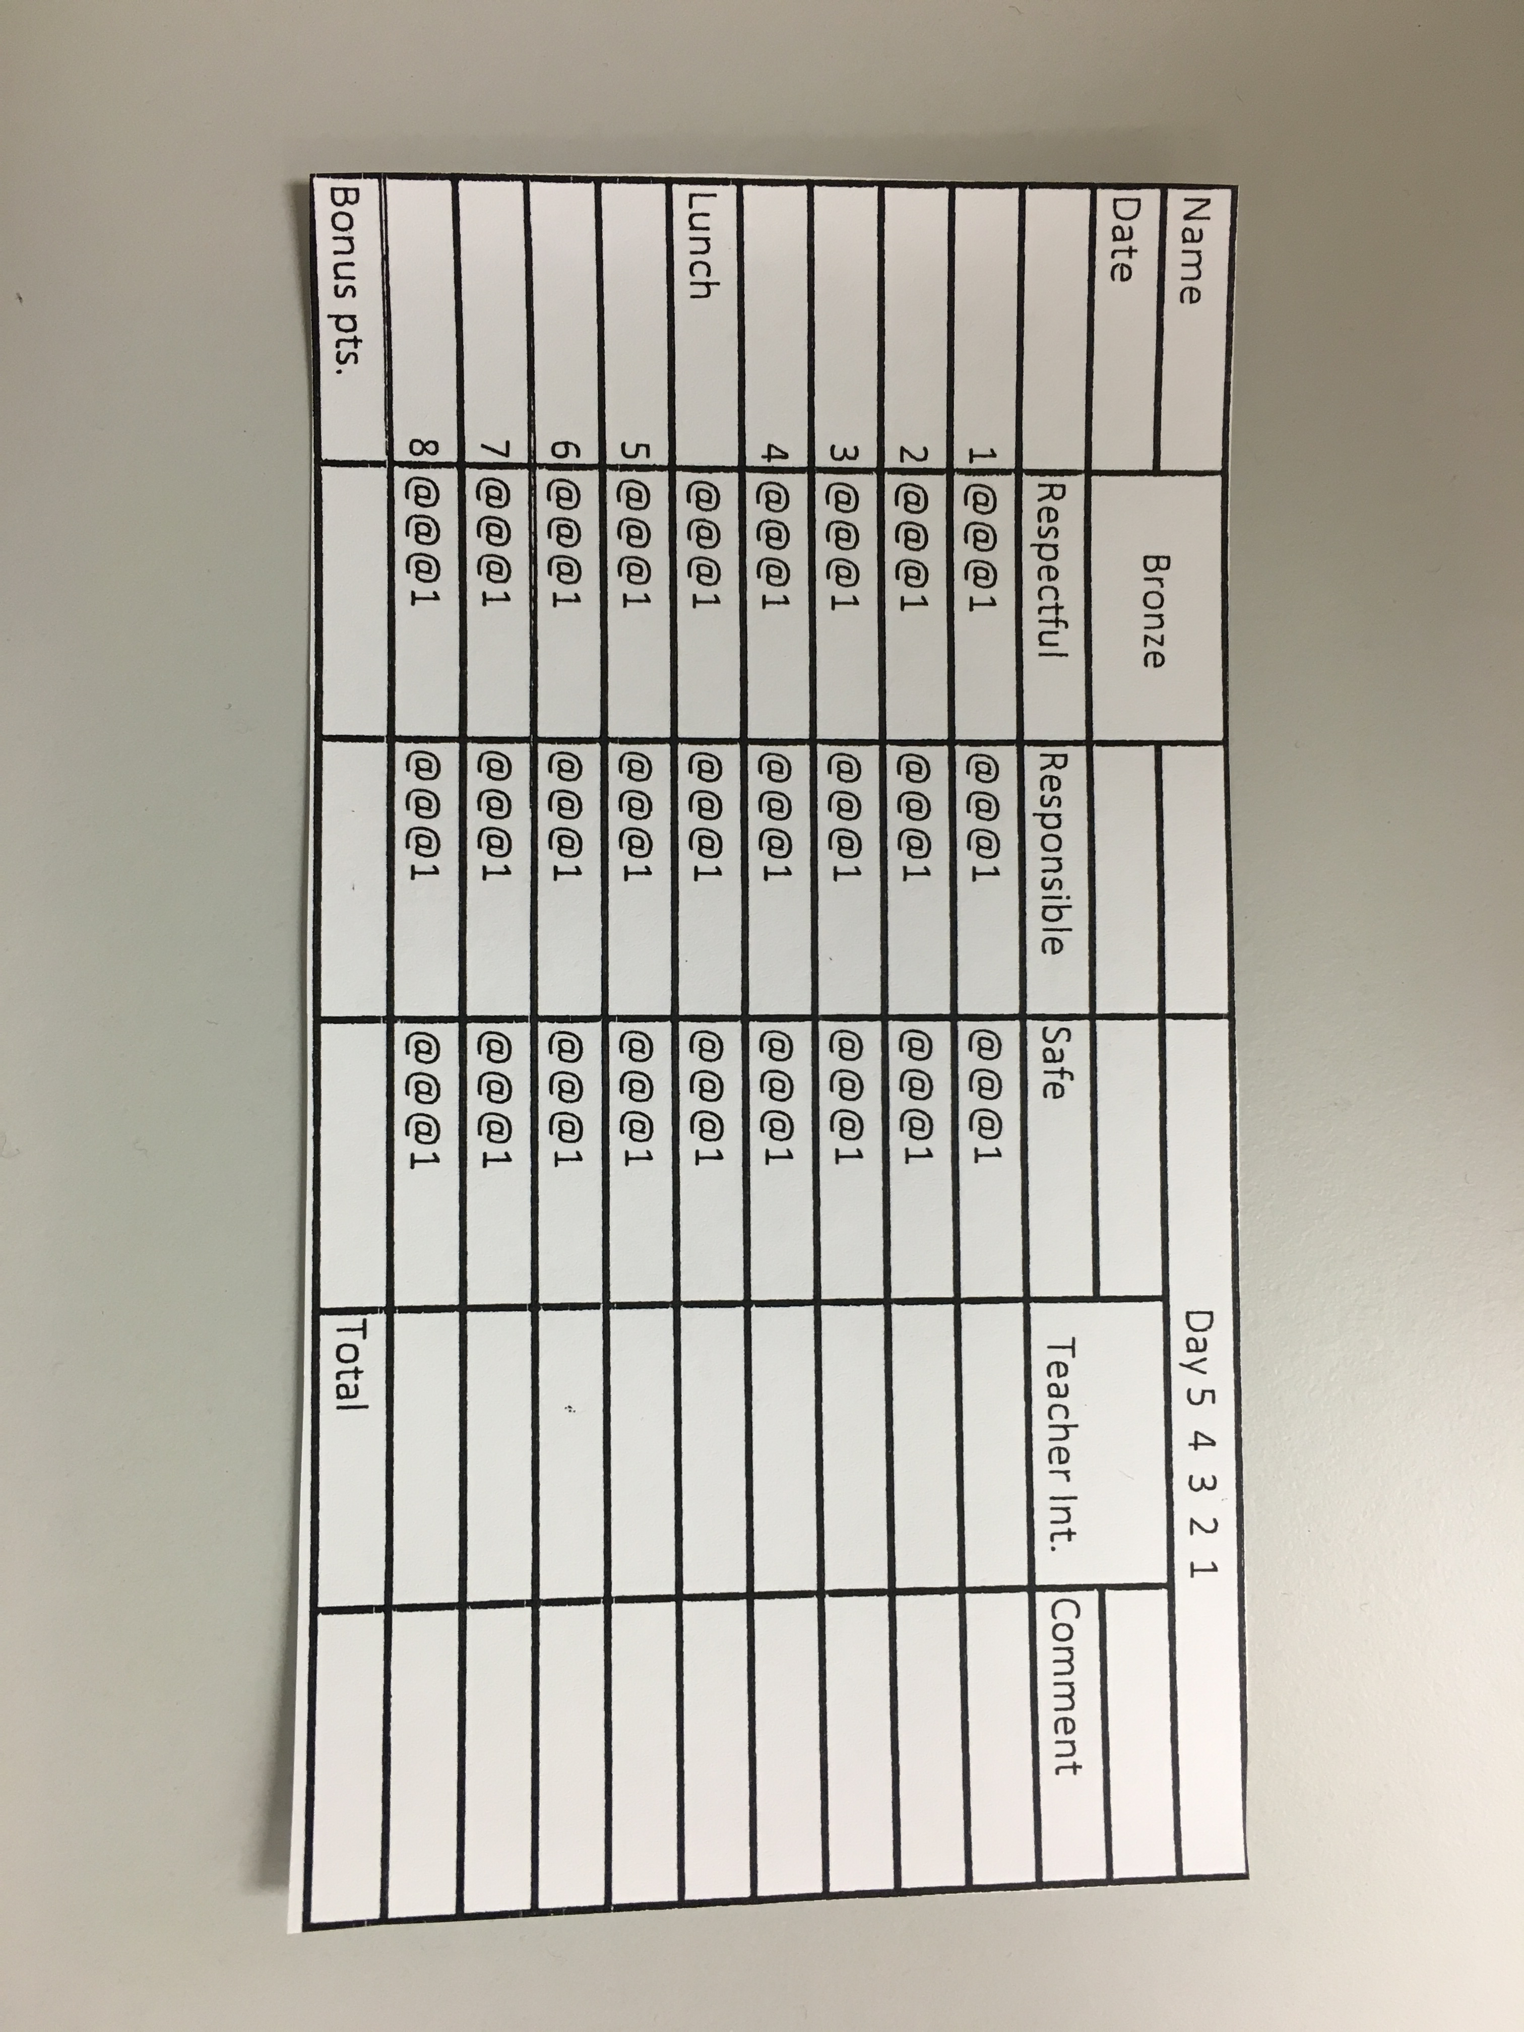
Bronze

Slide 16
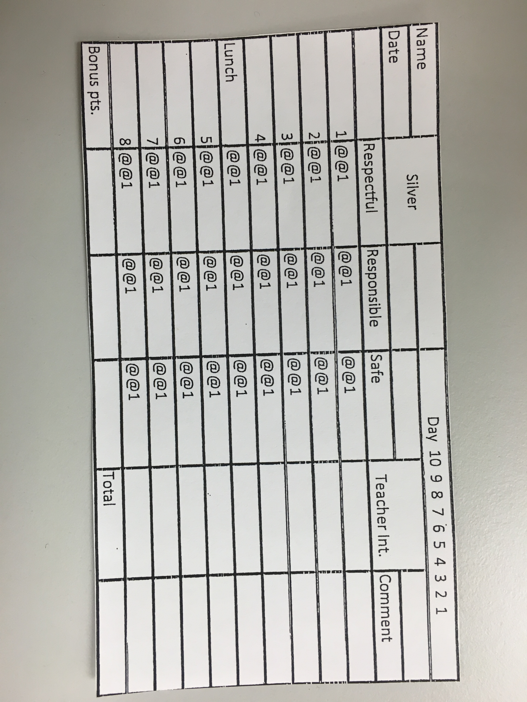
silver

Slide 17
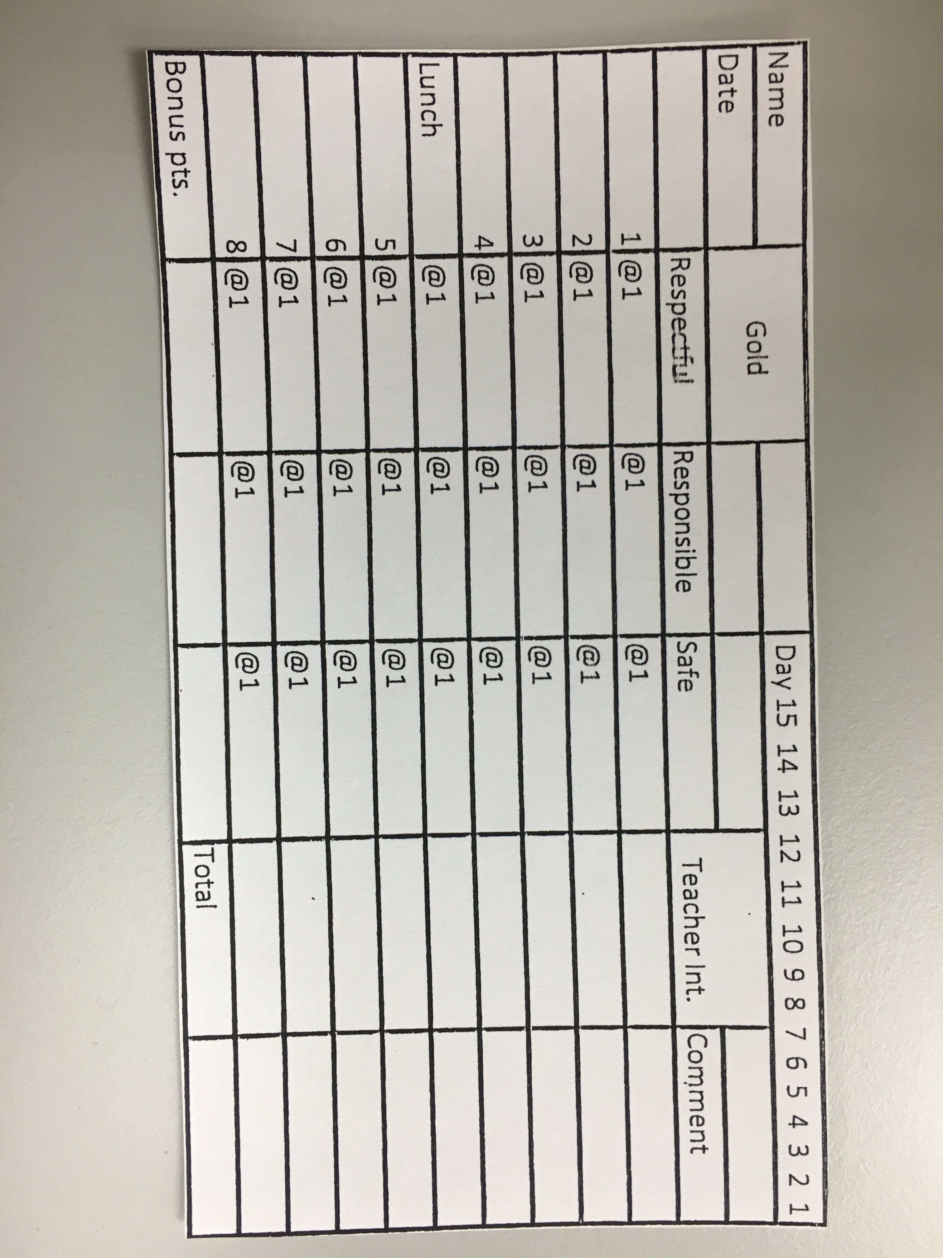
gold

Slide 18
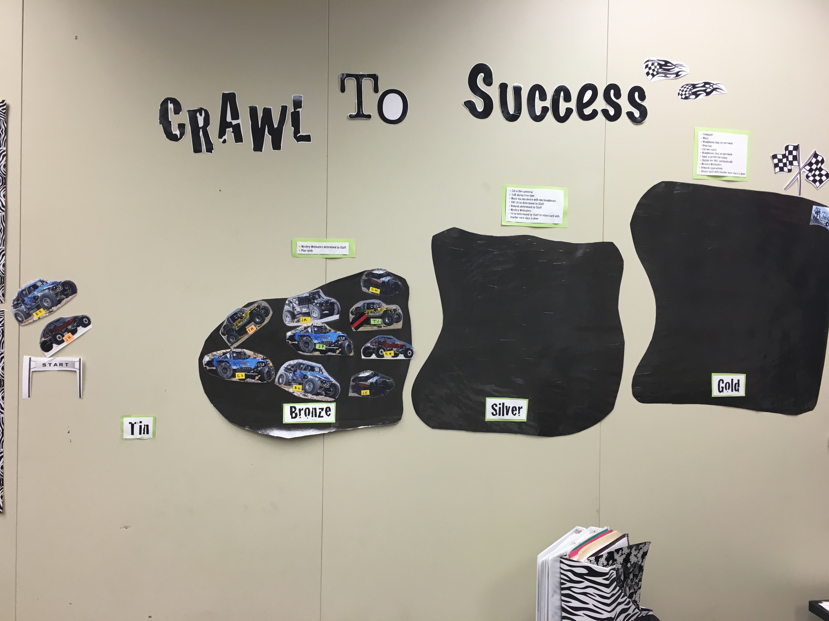
Tracking

Slide 19
tin
Office Referrals
Failing more than 20% of classes
Out of control behaviors
Non compliance/ argumentative
Removal from class for negative behaviors

Slide 20
tin
Must eat in the classroom for lunch
No “extras” will be allowed for lunch.
Restricted from all rewards
Must have 3 positive consecutive days to get off TIN.

Slide 21
Accountability
Accept responsibility for your actions.
Be accountable for your results.
Take ownership of your mistakes.

Slide 22
Contact
Please feel free to contact us with any questions!
Sierra Erdman, Emotional Support Teacher
serdman@indians.k12.pa.us
570-648-5731 ext 3210
Christin Hughes, School Social Worker
chughes@indians.k12.pa.us
570-648-5731 ext 3620

